Slide 1

Thera Bank: How to make personal loan business out of existing clients?
Present by: Jasmine Zeng

Slide 2

Background & Business Need
Thera bank wants to explore ways of converting its liability customers to personal loan customers
A campaign that the bank ran last year for liability customers showed a healthy conversion rate of over 9% success
Goal: to devise campaigns with better target marketing to increase the success ratio

Slide 3

Thera Bank Data
Demographic information
Age
Income
Professional experience year
Family Number
Education Level
Average Spending on Credit Card
Relationship with the bank
Mortgage
CD (Certificate of Deposit)
If use interbank facilities
Credit Cards
Securities Account
Personal Loan

Slide 4
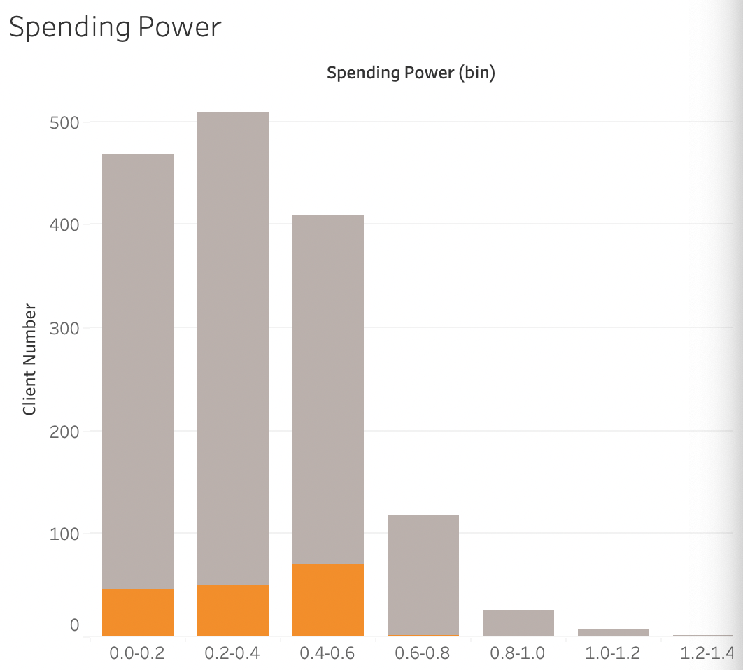

Observation 1: Conservative Clients who has big spending needs are potential clients for personal loan
Looking into those who has low spending power 0-0.4
 | Percentage of Large Family (3-4)
Clients who has personal loan | 54.9%
Clients who doesn't have personal loan | 30.2%
 | Percentage of Mortgage Holder
Clients who has personal loan | 34.5%
Clients who doesn't have personal loan | 30.2%
If we target on these clients …
Potentially 8% increase in conversion rate from this population
“conservative clients”
“dangerous clients”
Define: Spending Power= Average Credit Cards Spending/ Income

Slide 5
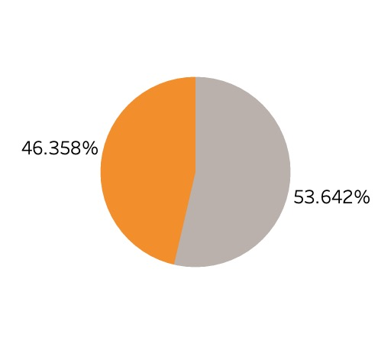
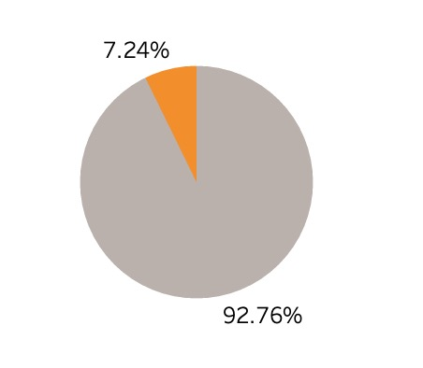
Observation 2: Clients who has CD with Thera Bank are more likely to accept personal loan offer
For clients who have CD accounts
For those who don’t
If we target on these clients …
Potentially 3.2% increase in conversion rate from this population

Slide 6

What is our solution?
Solution path:
Tech: build a classification model
Non-Tech(MVP):
target conservative clients who has large spending needs
target CD clients who have more trust on the bank
Criteria for Success:
Tech: Accurate model (ROC-AUC score)
Non-Tech: An increase in conversion rate

Slide 7

Risk and Assumptions
Assumption:
Enough liquidity in bank
Risk:
Low Credit Score Clients

Slide 8

Thank you!

Slide 9
Appendix – Personal Loan Purpose
For example, you might use a personal loan to cover:
Moving expenses
Debt consolidation
Medical bills
Wedding expenses
Home renovations or repairs
Funeral costs
Vacation costs
Unexpected expenses

